Slide 1
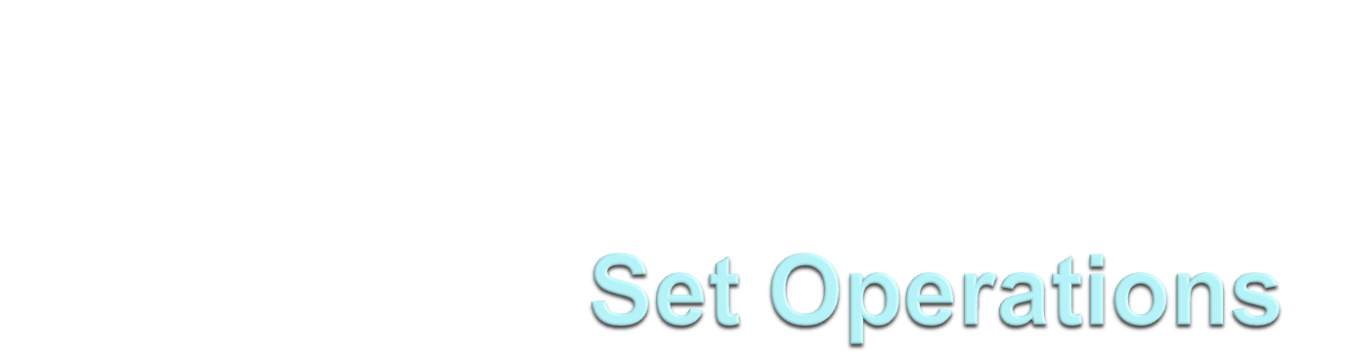
Rushdi Shams, Dept of CSE, KUET

Slide 2
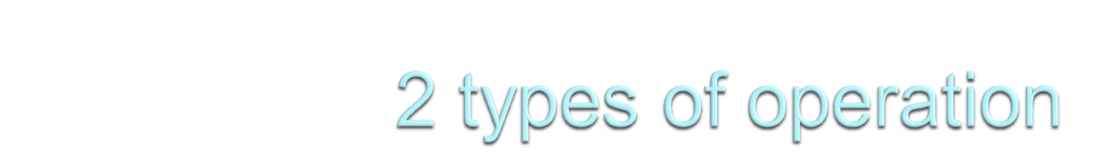
Set theory operations:
Union
Intersection
Difference

Slide 3
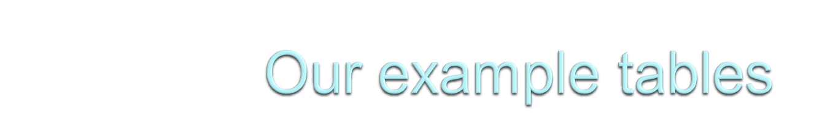
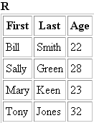
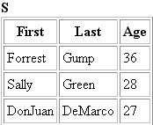
There are 2 tables- R and S, we will play with them!!

Slide 4
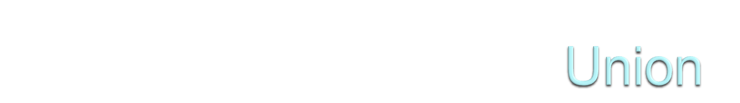
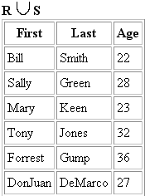
RUS means, a union operation on R and S that will produce another table which will have all the rows of R and S except the duplicates
There are 2 Sally in R and S, so, just take 1 from them

Slide 5
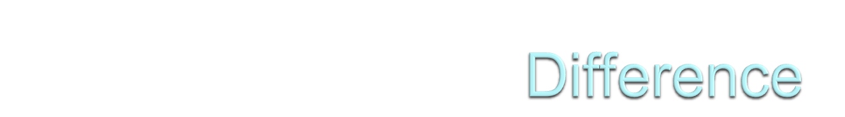
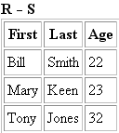
R-S means, a difference operation on R and S that will produce another table which will have all the rows which is in R but not in S.
As Sally is in R and in S, so, she has been omitted.

Slide 6
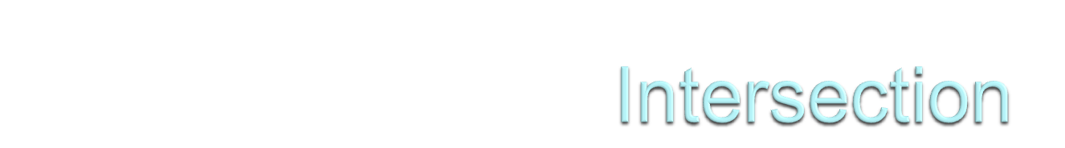

R∩S means, an intersection operation on R and S that will produce another table which will have all the rows which are in both R and S.
As Sally is in R and in S, so, she has been selected.

Slide 7
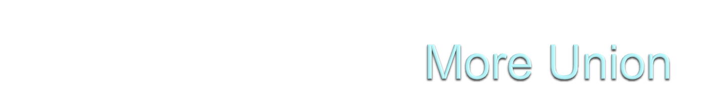
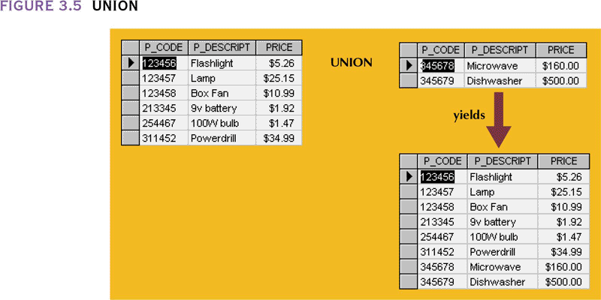

Slide 8
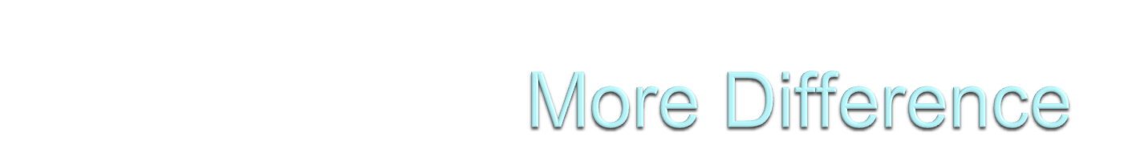
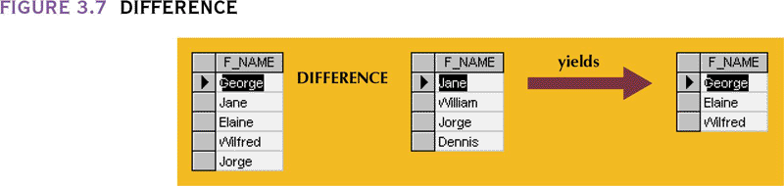

Slide 9
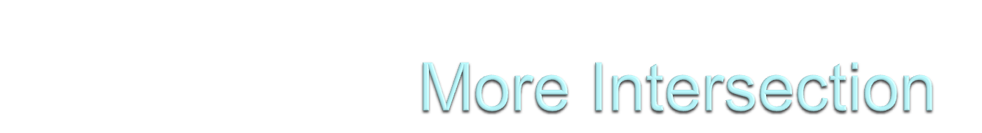
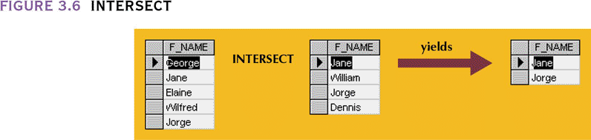

Slide 10
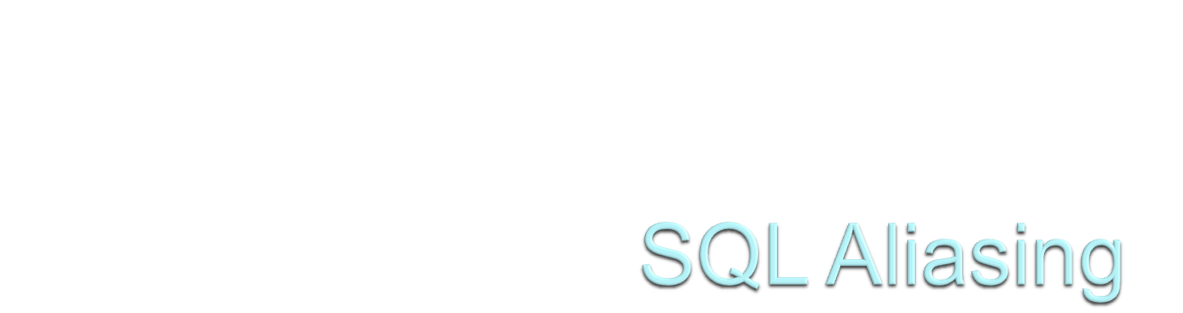

Slide 11
You can give a table or a column another name by using an alias.
This can be a good thing to do if you have very long or complex table names or column names.

Slide 12
SQL Alias Syntax for Tables
SELECT column_name(s)
FROM table_name AS alias_name
SQL Alias Syntax for Columns
SELECT column_name AS alias_name
FROM table_name

Slide 13




